Slide 1
If you have a laptop – please do connect to the wifi
WIFI – Sint-Pietersabdij Gent
Password - WELKOMINDEABDIJ

Slide 2




Deep active inference
Noor Sajid
Theoretical Neurobiology Group
WCHN, University College London
noorsajid.com
13th September 2023
@nsajidt

Slide 3
So, what is active inference?

Slide 4


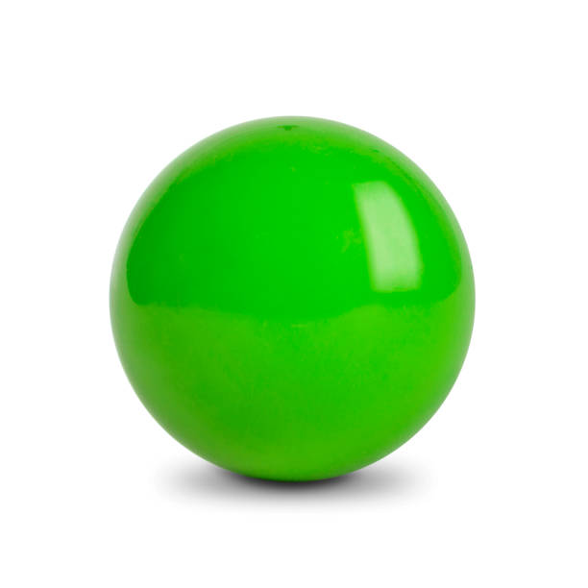
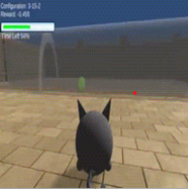



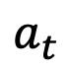
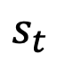
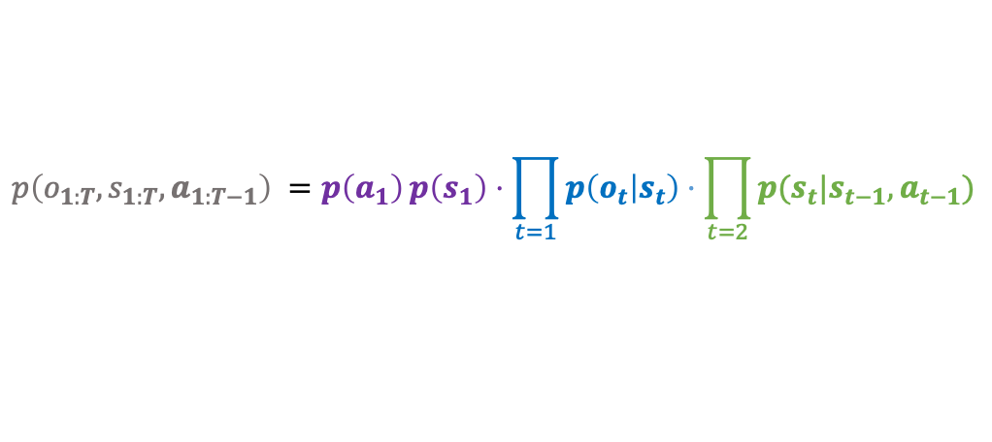
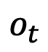
Under active inference, we first define the agent’s generative model
actions
latent states
$$a_{t}$$
$$s_{t}$$
$$o_{t}$$
agent
world
observations
partially observable MDP
priors
likelihood
transitions
$$p\left(o_{1:T},s_{1:T},a_{1:T−1}\right) =p\left(a_{1}\right){p\left(s_{1}\right)⋅\prod_{t=1}{p\left(o_{t} | s_{t}\right)}⋅\prod_{t=2}{p(s_{t}|s_{t−1},a_{t−1})}}$$
Sajid, Ball, et al Neural Computation, 2021;
Da Costa, Parr, Sajid, et al, Journal of Mathematical Psychology, 2020;
Friston, et al, Neural Computation, 2017
noorsajid.com

Slide 5
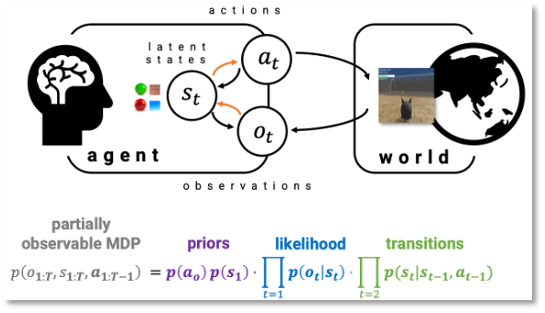
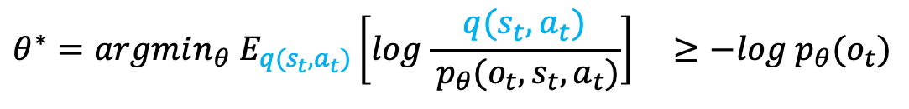
Next, we fit the model to observations using surprisal minimisation
… or variational free energy*:
define model
variational distribution
$$θ^{∗}=argmin_{θ} E_{q(s_{t},a_{t})}\left[log\frac{q(s_{t},a_{t})}{{ p}_{θ}(o_{t},s_{t},a_{t})}\right] ≥−log p_{θ}(o_{t})$$
*also known as the evidence lower bound in ML
Sajid, Ball, et al Neural Computation, 2021;
Da Costa, Parr, Sajid, et al, Journal of Mathematical Psychology, 2020;
Friston, et al, Neural Computation, 2017
noorsajid.com

Slide 6
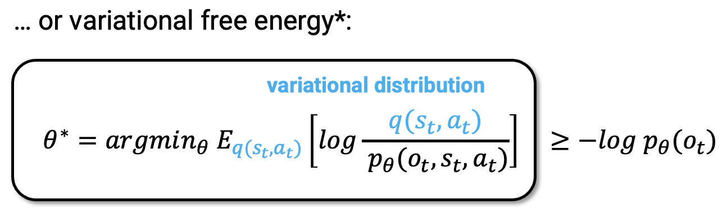
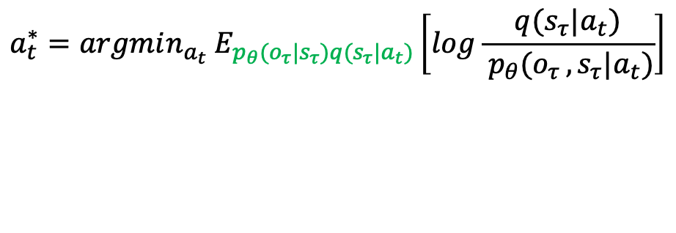
Given this model, we select actions that minimise uncertainty
… or expected free energy in the future $τ>t$:
define model
$$a_{t}^{∗}=argmin_{a_{t}} E_{p_{θ}(o_{τ}|s_{τ})q(s_{τ}|a_{t})}\left[log\frac{q(s_{τ}|a_{t})}{{ p}_{θ}(o_{τ },s_{τ}|a_{t})}\right]$$
model
fitting
Sajid, Ball, et al Neural Computation, 2021;
Da Costa, Parr, Sajid, et al, Journal of Mathematical Psychology, 2020;
Friston, et al, Neural Computation, 2017
noorsajid.com

Slide 7
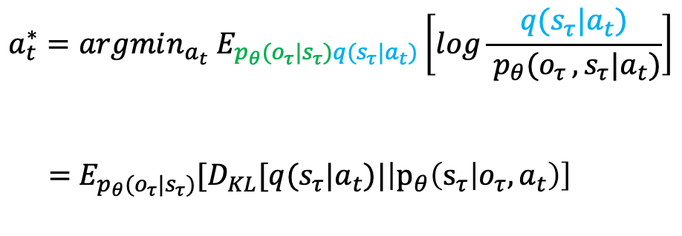
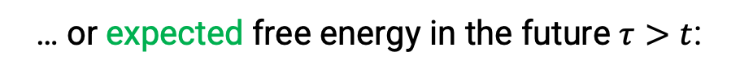
Given this model, we select actions that minimise uncertainty
… or expected free energy in the future $τ>t$:
define model
$$a_{t}^{∗}=argmin_{a_{t}} E_{p_{θ}(o_{τ}|s_{τ})q(s_{τ}|a_{t})}\left[log\frac{q(s_{τ}|a_{t})}{{ p}_{θ}(o_{τ },s_{τ}|a_{t})}\right]$$
$=$ $E_{p_{θ}(o_{τ}|s_{τ})}[D_{KL}[q(s_{τ}|a_{t})|\left|p_{θ}\left(s_{τ} | o_{τ},a_{t}\right)\right]$
preferred future observations
$$−log{ p}_{θ}(o_{t})]$$
model
fitting
Sajid, Ball, et al Neural Computation, 2021;
Da Costa, Parr, Sajid, et al, Journal of Mathematical Psychology, 2020;
Friston, et al, Neural Computation, 2017
noorsajid.com

Slide 8
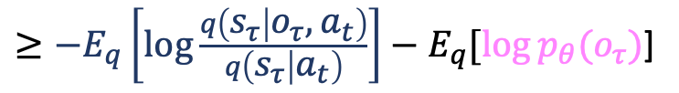
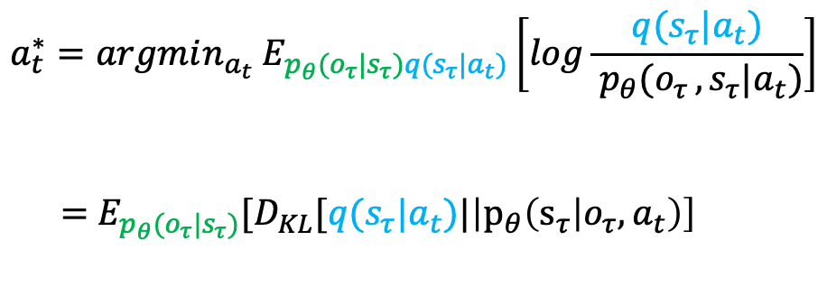
Given this model, we select actions that minimise uncertainty
… or expected free energy in the future $τ>t$:
define model
$$a_{t}^{∗}=argmin_{a_{t}} E_{p_{θ}(o_{τ}|s_{τ})q(s_{τ}|a_{t})}\left[log\frac{q(s_{τ}|a_{t})}{{ p}_{θ}(o_{τ },s_{τ}|a_{t})}\right]$$
$=$ $E_{p_{θ}(o_{τ}|s_{τ})}[D_{KL}[q(s_{τ}|a_{t})|\left|p_{θ}\left(s_{τ} | o_{τ},a_{t}\right)\right]$
preferred future observations
$$−log{ p}_{θ}(o_{t})]$$
model
fitting
$≥−E_{q}\left[\log{\frac{q\left(s_{τ} | o_{τ},a_{t}\right)}{q\left(s_{τ} | a_{t}\right)}}\right]−E_{q}[log⁡p_{θ}(o_{τ})$]
Information-based exploration
Sajid, Ball, et al Neural Computation, 2021;
Da Costa, Parr, Sajid, et al, Journal of Mathematical Psychology, 2020;
Friston, et al, Neural Computation, 2017
noorsajid.com

Slide 9
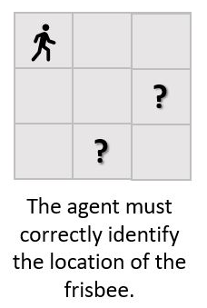
In stochastic settings, discrete active inferences exhibit one-shot learning
Comparisons:
1. Q-Learning using ε - greedy exploration
2. Bayesian model-based reinforcement learning using Thompson sampling
noorsajid.com
*Results from Sajid, Ball, et al Neural Computation, 2021;

Slide 10
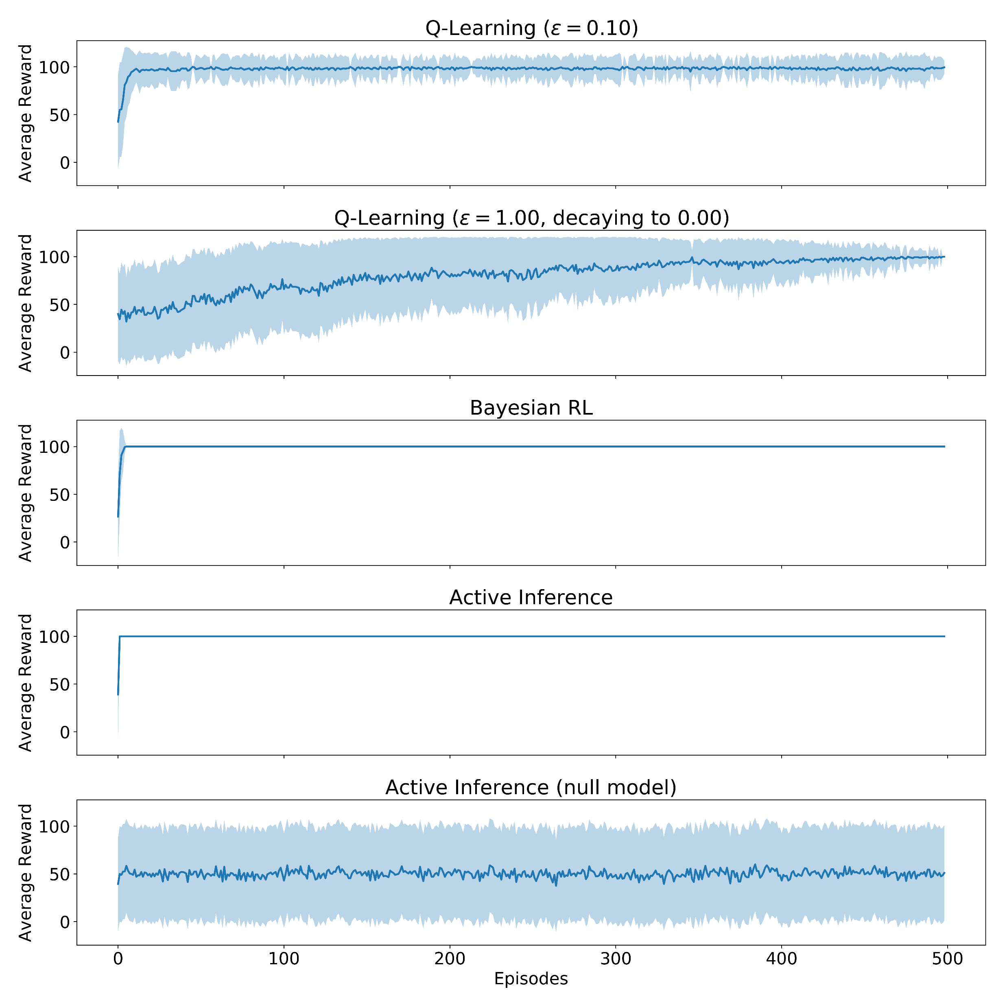
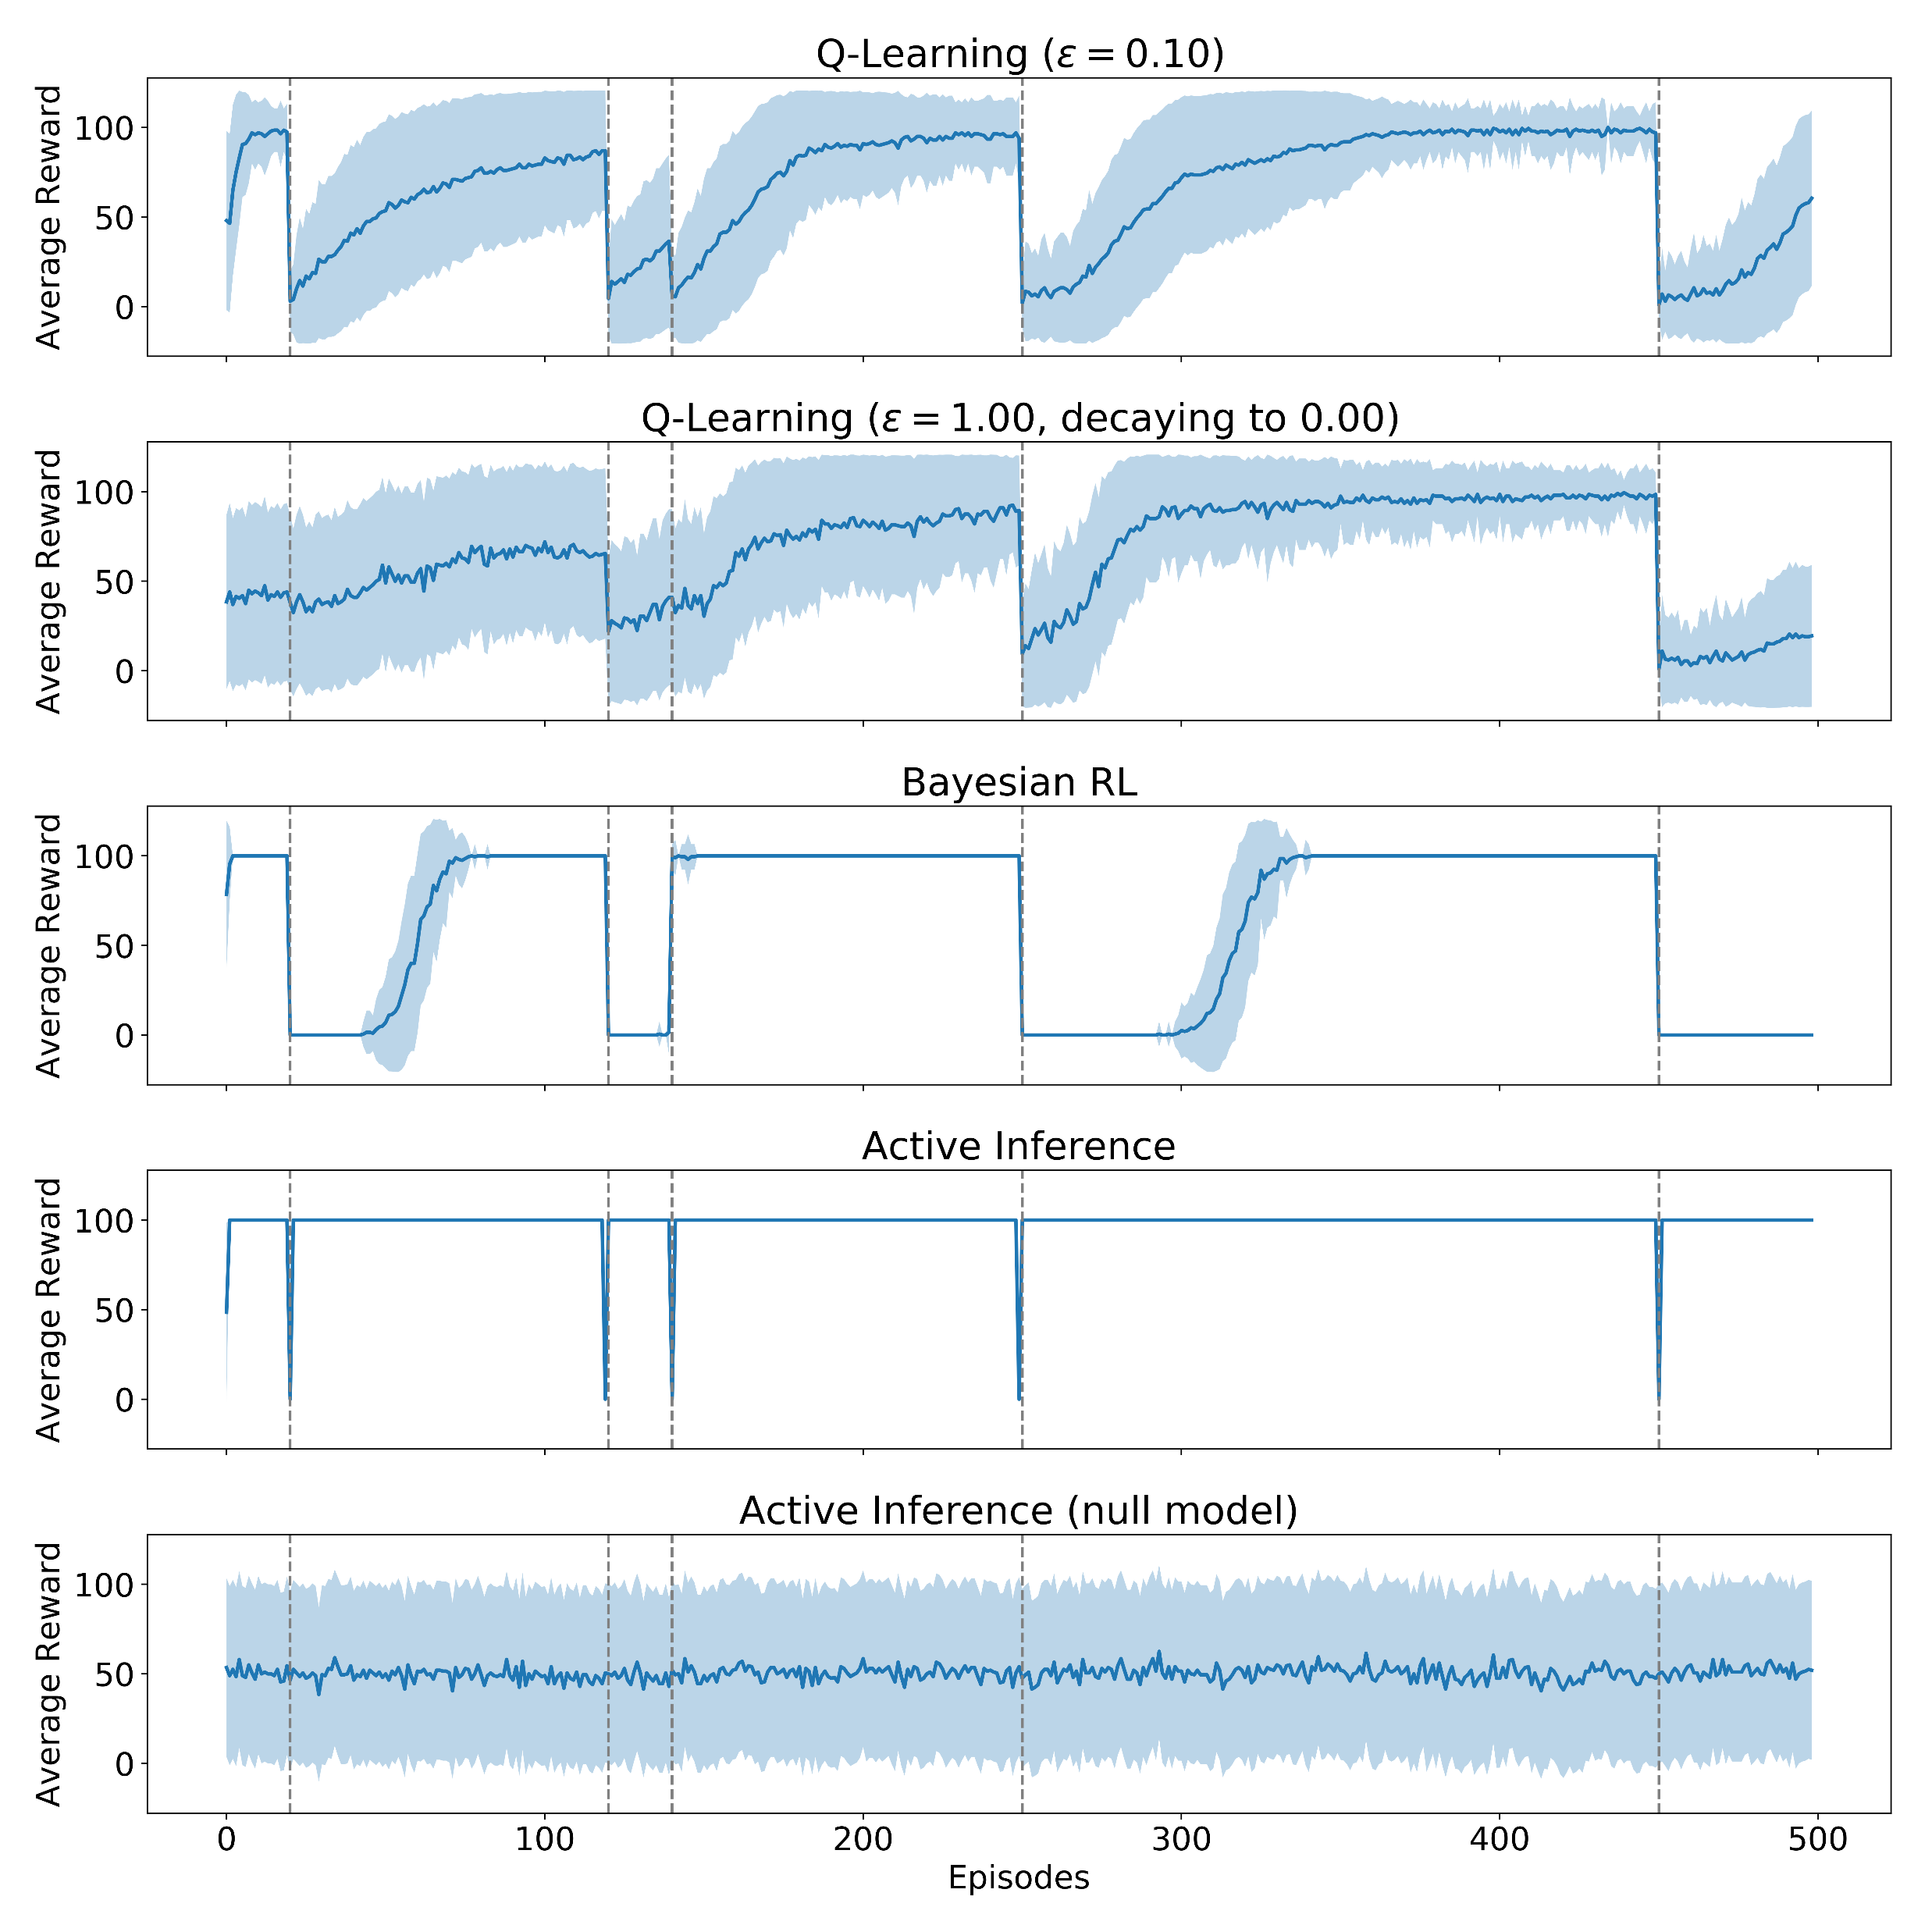
In stochastic settings, discrete active inferences exhibit one-shot learning
Comparisons:
1. Q-Learning using ε - greedy exploration
2. Bayesian model-based reinforcement learning using Thompson sampling
Deterministic = consistent frisbee location
Stochastic = frisbee location changes N steps
noorsajid.com
*Results from Sajid, Ball, et al Neural Computation, 2021;

Slide 11
However, despite its potential in modelling meaningful behaviour, implementations have been largely restricted to low-dimensional, discrete state-space tasks… In this tutorial, we consider how to formulate a deep active inference agent for visual control.
Sajid, Ball, et al Neural Computation, 2021;
Da Costa, Parr, Sajid, et al, Journal of Mathematical Psychology, 2020;
Friston, et al, Neural Computation, 2017
noorsajid.com

Slide 12
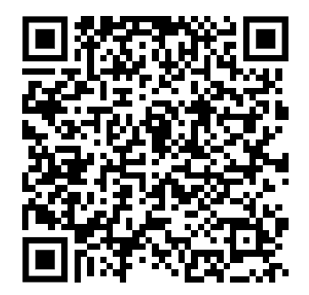
Instructions
https://bitly.ws/UvMe
Make sure you have signed in with your Google account
Click “File > Save a copy in Drive” to create your own copy
Let’s play around with the demo using your own copy!
noorsajid.com

Slide 13
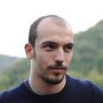
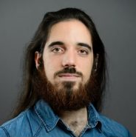
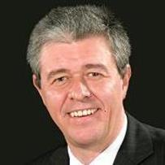
How to define a deep active inference agent?
Equipping agents with slow and fast planning using uncertainty minimisation
Learn a deep generative model
How well does this agent perform?
Zafeirios Fountas
Pedro Mediano
Karl Friston
noorsajid.com/daimc
Fountas, Sajid, et al, NeurIPs, 2020

Slide 14
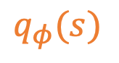
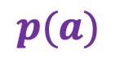
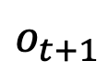
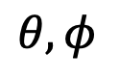
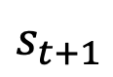
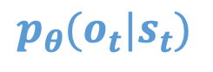
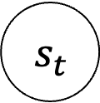
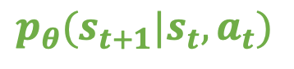
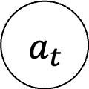
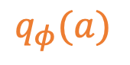
We used multiple neural networks to parameterise the generative model
$a_{t}$
$$p(a)$$
action prior
$$q_{φ}(a)$$
$s_{t}$
$$p_{θ}(s_{t+1}|s_{t}, a_{t})$$
$$s_{t+1}$$
transitions
$$q_{φ}(s)$$
$$p_{θ}(o_{t}|s_{t})$$
likelihood
$$θ,φ$$
: neural networks weights
$$o_{t+1}$$
past
present
noorsajid.com/daimc
Fountas, Sajid, et al, NeurIPs, 2020

Slide 15
We used multiple neural networks to parameterise the generative model
$a_{t}$
$$p(a)$$
action prior
$$q_{φ}(a)$$
$s_{t}$
$$p_{θ}(s_{t+1}|s_{t}, a_{t})$$
$$s_{t+1}$$
transitions
$$q_{φ}(s)$$
$$p_{θ}(o_{t}|s_{t})$$
likelihood
$$θ,φ$$
: neural networks weights
$$o_{t+1}$$
``
Switch over to colab
past
present
noorsajid.com/daimc
Fountas, Sajid, et al, NeurIPs, 2020

Slide 16
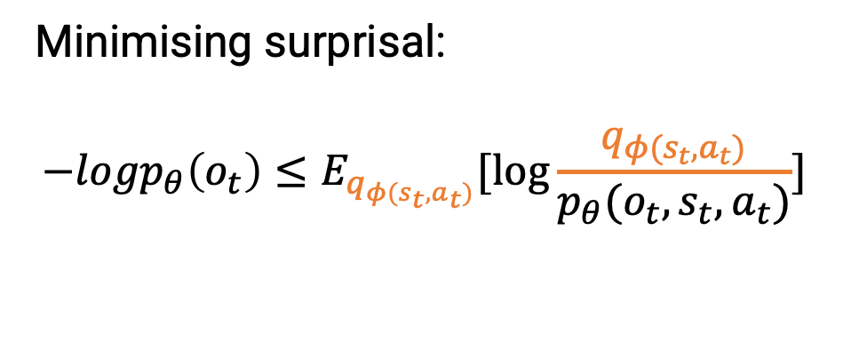
The generative model was optimised using the same variational objective
$a_{t}$
Minimising surprisal:
$${{−logp}_{θ}\left(o_{t}\right)≤E}_{q_{φ{(s}_{t},a_{t})}}[\log{\frac{q_{φ{(s}_{t},a_{t})}}{{p_{θ}(o_{t}, s}_{t},a_{t})}]}$$
$$p(a)$$
action prior
$$q_{φ}(a)$$
$s_{t}$
$$p_{θ}(s_{t+1}|s_{t}, a_{t})$$
$$s_{t+1}$$
transitions
$$q_{φ}(s)$$
$$p_{θ}(o_{t}|s_{t})$$
likelihood
$$θ,φ$$
: neural networks weights
$$o_{t+1}$$
past
present
noorsajid.com/daimc
Fountas, Sajid, et al, NeurIPs, 2020

Slide 17
The generative model was optimised using the same variational objective
$a_{t}$
Minimising surprisal:
$${{−logp}_{θ}\left(o_{t}\right)≤E}_{q_{φ{(s}_{t},a_{t})}}[\log{\frac{q_{φ{(s}_{t},a_{t})}}{{p_{θ}(o_{t}, s}_{t},a_{t})}]}$$
$$p(a)$$
action prior
$$q_{φ}(a)$$
$s_{t}$
$$p_{θ}(s_{t+1}|s_{t}, a_{t})$$
$$s_{t+1}$$
transitions
$$q_{φ}(s)$$
$$p_{θ}(o_{t}|s_{t})$$
likelihood
$$θ,φ$$
: neural networks weights
$$o_{t+1}$$
``
Switch over to colab
past
present
noorsajid.com/daimc
Fountas, Sajid, et al, NeurIPs, 2020

Slide 18
How to define a deep active inference agent?
Equipping agents with slow and fast planning using uncertainty minimisation
Learn a deep generative model
How well does this agent perform?
Zafeirios Fountas
Pedro Mediano
Karl Friston
noorsajid.com/daimc
Fountas, Sajid, et al, NeurIPs, 2020

Slide 19
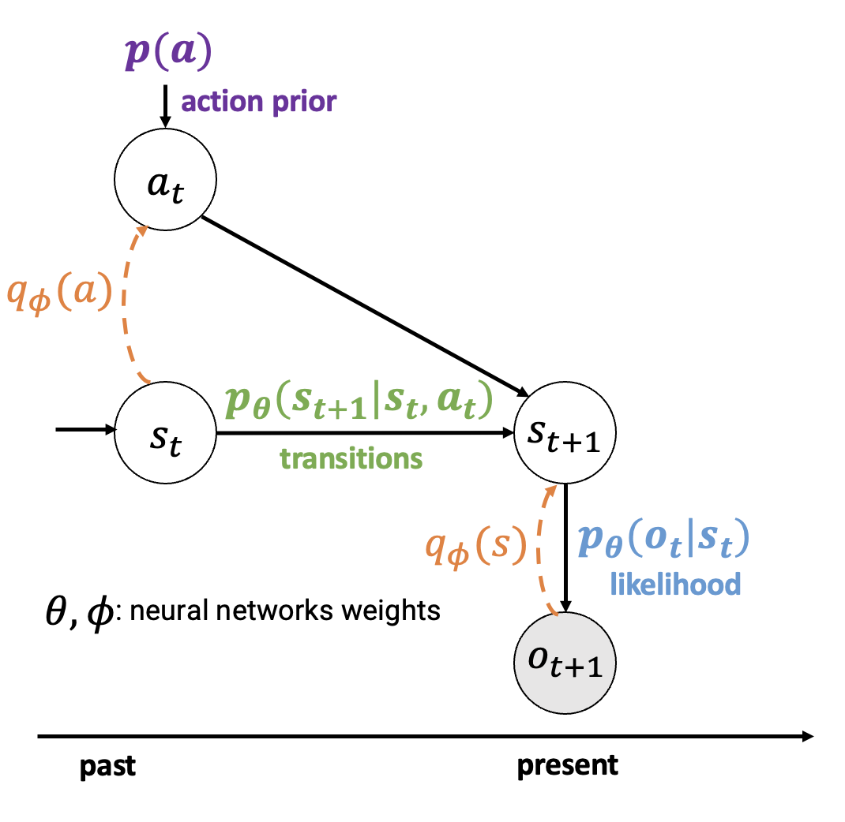
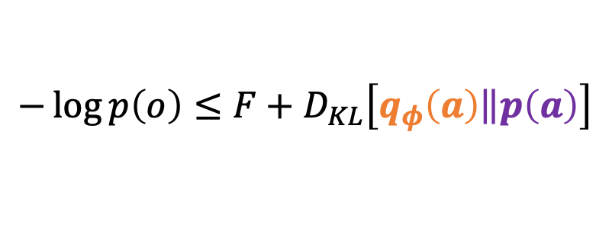
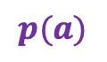
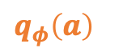
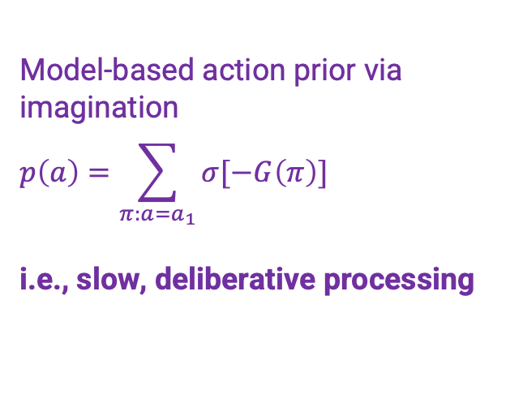
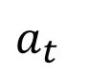
For action selection, we introduced two systems…
Model-based action prior via imagination
$$p\left(a\right)=\sum_{π:a=a_{1}}{σ[−G\left(π\right)]}$$
i.e., slow, deliberative processing
$$p(a)$$
$$a_{t}$$
Model-free action posterior via a habitual network
i.e., fast processing
$q_{φ}\left(a\right)$
$$−\log{p\left(o\right)}≤F+D_{KL}\left[q_{φ}\left(a\right)\left\|p\left(a\right)\right.\right]$$
noorsajid.com/daimc
Fountas, Sajid, et al, NeurIPs, 2020

Slide 20
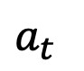
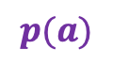
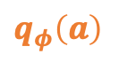
For action selection, we introduced two systems…
Model-based action prior via imagination
$$p\left(a\right)=\sum_{π:a=a_{1}}{σ[−G\left(π\right)]}$$
i.e., slow, deliberative processing
$$p(a)$$
$$a_{t}$$
Model-free action posterior via a habitual network
i.e., fast processing
$q_{φ}\left(a\right)$
``
Switch over to colab
$$−\log{p\left(o\right)}≤F+D_{KL}\left[q_{φ}\left(a\right)\left\|p\left(a\right)\right.\right]$$
noorsajid.com/daimc
Fountas, Sajid, et al, NeurIPs, 2020

Slide 21
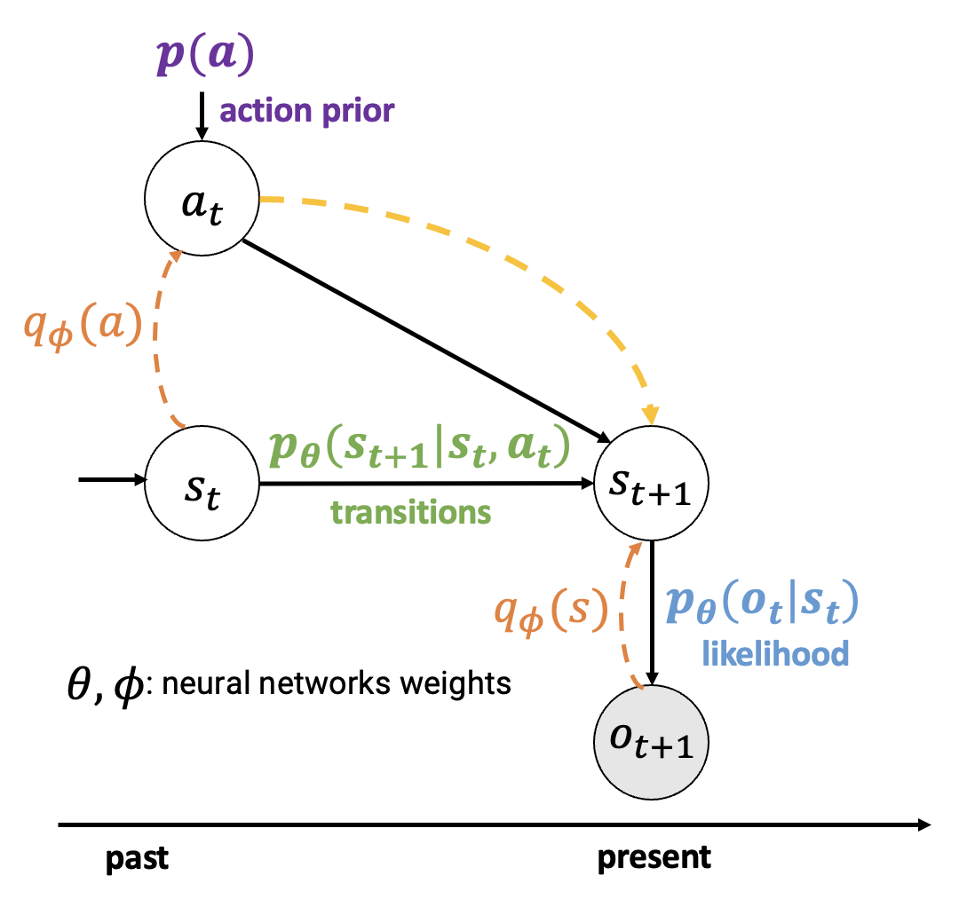
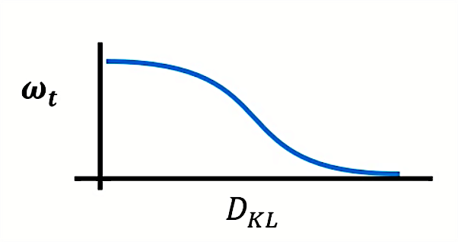

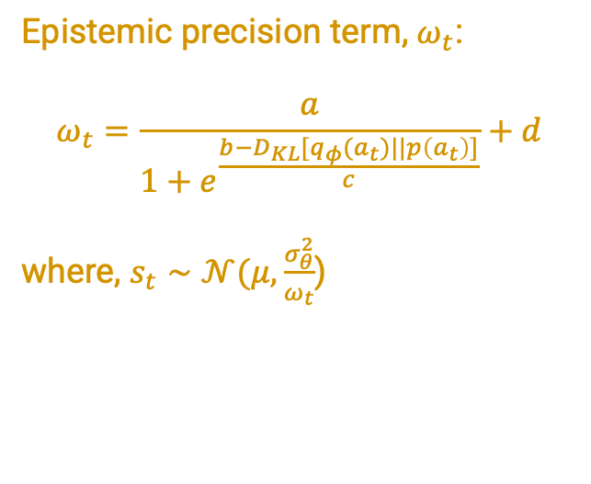
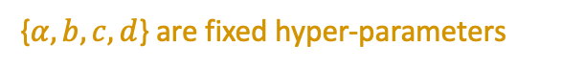
We traded-off between them using top-down attention…
Epistemic precision term, $ω_{t}$:
$$ω_{t}=\frac{a}{1+e^{\frac{b−D_{KL}[q_{φ}(a_{t})||p\left(a_{t}\right)]}{c}}}+d$$
where, $s_{t}∼𝒩(μ,\frac{σ_{θ}^{2}}{ω_{t}}$)
$$ω_{t}$$
{$α, b, c, d$} are fixed hyper-parameters
noorsajid.com/daimc
Fountas, Sajid, et al, NeurIPs, 2020

Slide 22
We traded-off between them using top-down attention…
Epistemic precision term, $ω_{t}$:
$$ω_{t}=\frac{a}{1+e^{\frac{b−D_{KL}[q_{φ}(a_{t})||p\left(a_{t}\right)]}{c}}}+d$$
where, $s_{t}∼𝒩(μ,\frac{σ_{θ}^{2}}{ω_{t}}$)
$$ω_{t}$$
``
{$α, b, c, d$} are fixed hyper-parameters
Switch over to colab
noorsajid.com/daimc
Fountas, Sajid, et al, NeurIPs, 2020

Slide 23
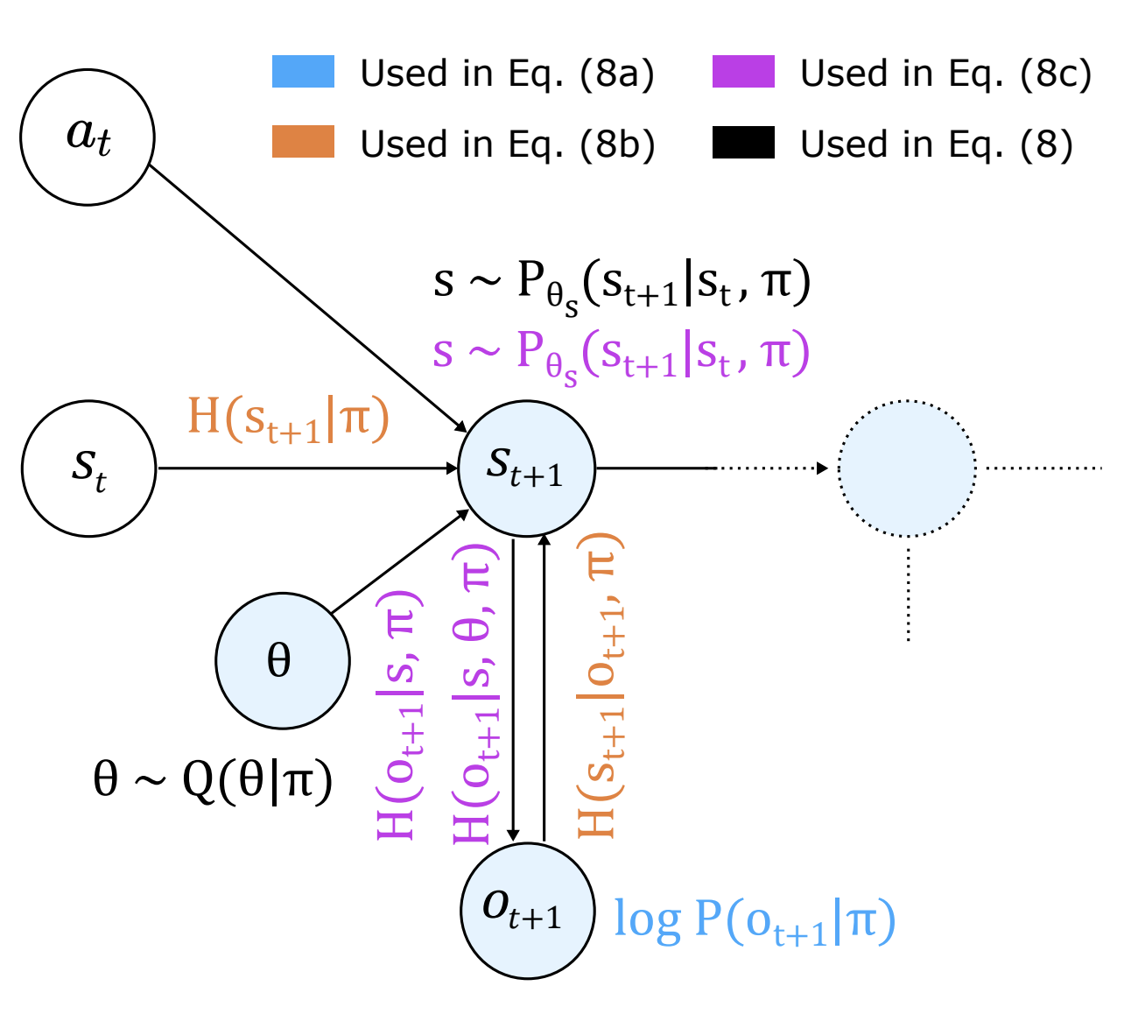
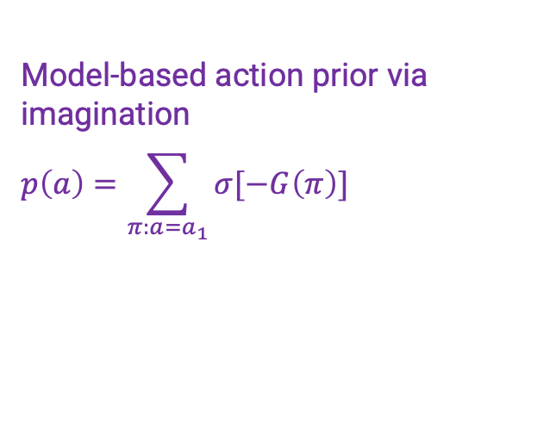
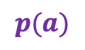
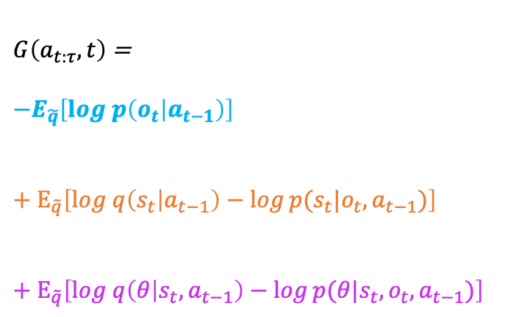
Our action prior was calculated using Monte-Carlo sampling
$$p(a)$$
Model-based action prior via imagination
$$p\left(a\right)=\sum_{π:a=a_{1}}{σ[−G\left(π\right)]}$$
$$a_{t}$$
$G\left(a_{t:τ},t\right)$ =
$${−Ε}_{\tilde{q}}\left[log p\left(o_{t} | a_{t−1}\right)\right]$$
$$+{ Ε}_{\tilde{q}}\left[log q\left(s_{t} | a_{t−1}\right)−\log{p(s_{t}|o_{t},a_{t−1})}\right]$$
$$+ Ε_{\tilde{q}}\left[log q\left(θ | s_{t}, a_{t−1}\right)−\log{p({θ|s}_{t},o_{t},a_{t−1})}\right]$$
likelihood of observations
state information gain
present
future
parameter information gain
noorsajid.com/daimc
Fountas, Sajid, et al, NeurIPs, 2020

Slide 24
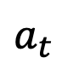



Our action prior was calculated using Monte-Carlo sampling
$$p(a)$$
Model-based action prior via imagination
$$p\left(a\right)=\sum_{π:a=a_{1}}{σ[−G\left(π\right)]}$$
$$a_{t}$$
$G\left(a_{t:τ},t\right)$ =
$${−Ε}_{\tilde{q}}\left[log p\left(o_{t} | a_{t−1}\right)\right]$$
$$+{ Ε}_{\tilde{q}}\left[log q\left(s_{t} | a_{t−1}\right)−\log{p(s_{t}|o_{t},a_{t−1})}\right]$$
$$+ Ε_{\tilde{q}}\left[log q\left(θ | s_{t}, a_{t−1}\right)−\log{p({θ|s}_{t},o_{t},a_{t−1})}\right]$$
Monte Carlo tree search (MCTS)
likelihood of observations
$$q_{φ}\left(a_{t}\right)$$
state information gain
present
future
parameter information gain
noorsajid.com/daimc
Fountas, Sajid, et al, NeurIPs, 2020

Slide 25
Our action prior was calculated using Monte-Carlo sampling
$$p(a)$$
Model-based action prior via imagination
$$p\left(a\right)=\sum_{π:a=a_{1}}{σ[−G\left(π\right)]}$$
$$a_{t}$$
$G\left(a_{t:τ},t\right)$ =
$${−Ε}_{\tilde{q}}\left[log p\left(o_{t} | a_{t−1}\right)\right]$$
$$+{ Ε}_{\tilde{q}}\left[log q\left(s_{t} | a_{t−1}\right)−\log{p(s_{t}|o_{t},a_{t−1})}\right]$$
$$+ Ε_{\tilde{q}}\left[log q\left(θ | s_{t}, a_{t−1}\right)−\log{p({θ|s}_{t},o_{t},a_{t−1})}\right]$$
Monte Carlo tree search (MCTS)
likelihood of observations
$$q_{φ}\left(a_{t}\right)$$
state information gain
``
Switch over to colab
present
future
parameter information gain
noorsajid.com/daimc
Fountas, Sajid, et al, NeurIPs, 2020

Slide 26
How to define a deep active inference agent?
Equipping agents with slow and fast planning using uncertainty minimisation
Learn a deep generative model
How well does this agent perform?
Zafeirios Fountas
Pedro Mediano
Karl Friston
noorsajid.com/daimc
Fountas, Sajid, et al, NeurIPs, 2020

Slide 27


To evaluate our agent, we constructed a new task…
Dynamic dSprites Task
Sorting dSprites objects to the correct place at the bottom, depending on the shape.
noorsajid.com/daimc
Fountas, Sajid, et al, NeurIPs, 2020

Slide 28
To evaluate our agent, we constructed a new task…
Dynamic dSprites Task
Sorting dSprites objects to the correct place at the bottom, depending on the shape.
``
Switch over to colab
noorsajid.com/daimc
Fountas, Sajid, et al, NeurIPs, 2020

Slide 29



$$q_{φ}(a)$$
habit
$$p(a)$$
planner
Reward-seeking
active inference /parameter infogain
active inference
noorsajid.com/daimc
Fountas, Sajid, et al, NeurIPs, 2020

Slide 30

In this environment, our agent explored more and learnt the task more accurately than a purely reward-seeking agent…
reward-seeking
active inference /parameter infogain
active inference
active inference /parameter infogain
+ downweighed reward
Reward-seeking
active inference /parameter infogain
active inference
noorsajid.com/daimc
Fountas, Sajid, et al, NeurIPs, 2020

Slide 31

The top-down precision $ω$is analogous to$β$ in $β$VAE…
Higgens et al, 2017;
Fountas, Sajid, et al, NeurIPs, 2020
noorsajid.com/daimc

Slide 32




We find that state prior precision induces disentanglement..
The top-down precision $ω$is analogous to$β$ in $β$VAE…
reward-seeking
active inference /parameter infogain
active inference
active inference /parameter infogain
+ downweighed reward
fixed $ω$
Higgens et al, 2017;
Fountas, Sajid, et al, NeurIPs, 2020
noorsajid.com/daimc

Slide 33

Does this performance scale up in 3D environments?
Animal AI Preferences Task
Find green objects and avoid re d ones
noorsajid.com/daimc
Fountas, Sajid, et al, NeurIPs, 2020

Slide 34

In this task, our agent performed competitively against model-free RL
Animal AI Preferences Task
Find green objects and avoid re d ones
noorsajid.com/daimc
Fountas, Sajid, et al, NeurIPs, 2020

Slide 35


Performance was consistent till 50% of observations were dropped
Animal AI Preferences Task
Find green objects and avoid re d ones despite visual blackouts
noorsajid.com/daimc
Fountas, Sajid, et al, NeurIPs, 2020

Slide 36
(some) open-challenges
Encoding generative models:
Generalisation & decomposability of encoded states
Structured priors
Temporal representations
Planning:
Hierarchical planning
Meta-control
Novel imagination
Preference models
This formulates one way of scaling up active inference
noorsajid.com/daimc

Slide 37





Thank you
…and many more
Thank you!
noorsajid.com
@nsajidt

